Slide 1
Informative speech
By: Labib Rahman
ID: 1931740642

Slide 2
Salman Khan

Slide 3
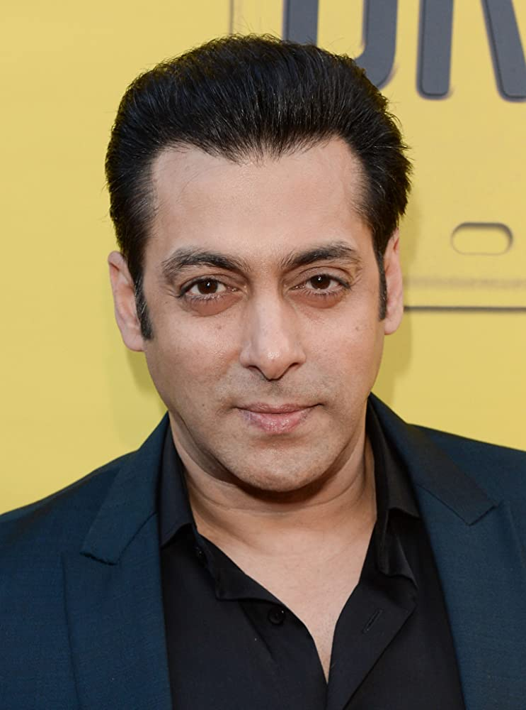

Slide 4
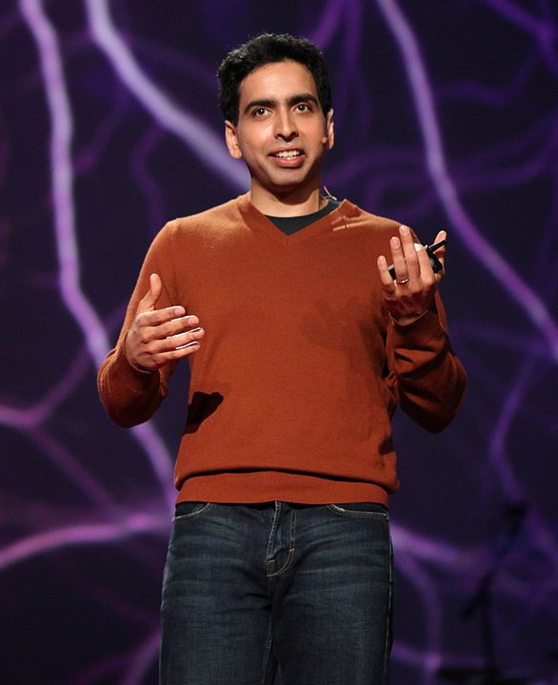

Slide 5
A little background:
Born in the United States, to a Bengali family. His father was from Barisal, Bangladesh, and his mother was from India. He graduated valedictorian in 1994.
Khan attended the Massachusetts Institute of Technology (MIT) where he got two bachelors degrees.
Khan also holds a Master of Business Administration from Harvard Business School.
Founder of Khan Academy

Slide 6
Khan Academy
American non-profit educational organization created in 2008
Produces short lessons in the form of videos.
Includes supplementary practice exercises and materials for educators. All resources are available for free to users of the website and app.

Slide 7
How Salman started Khan Academy:
In 2008 when Salman Khan tutored one of his cousins in mathematics on the Internet using a service called Yahoo! Doodle Images. After a while, Khan's other cousins began to use his tutoring service. Due to the demand, Khan decided to make his videos watchable on the Internet, so he published his content on YouTube.

Slide 8
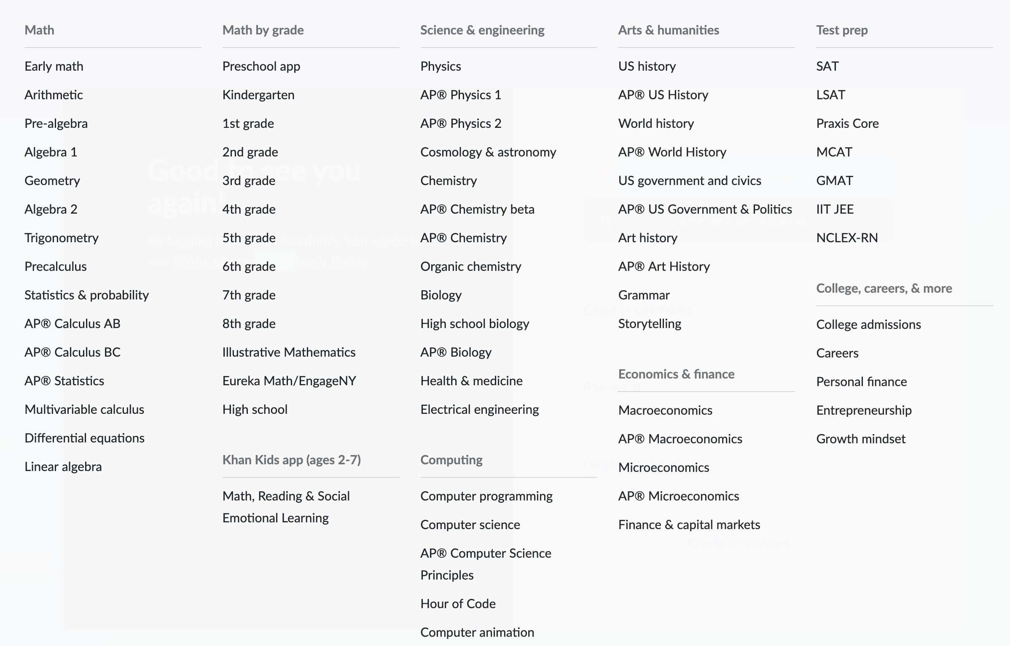
Content on Khan Academy:

Slide 9
Why his work on Khan Academy is relevant?
Over 6,500 videos
Wide range of topics
Difficult concepts explained

Slide 10
Thank You!

